Slide 1
Ctrl + Alt + Plastic
Say hello to plastic

Slide 2
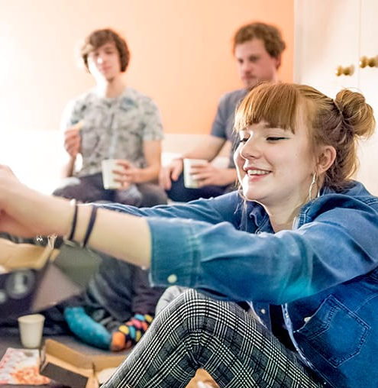

Who?

Slide 3
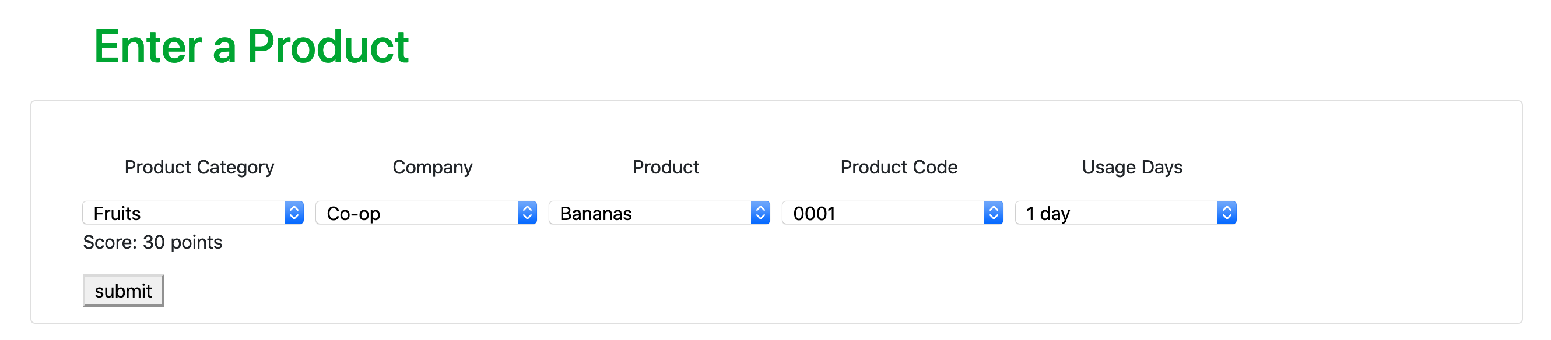
What?

Slide 4
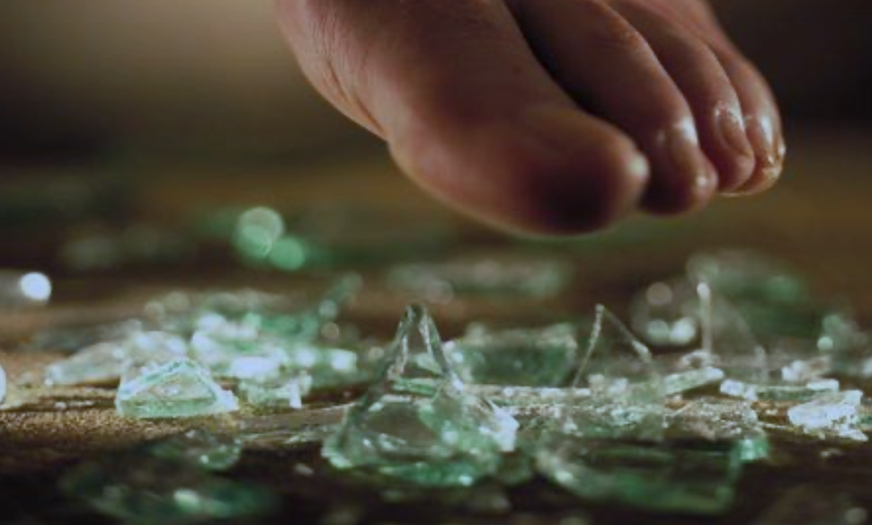
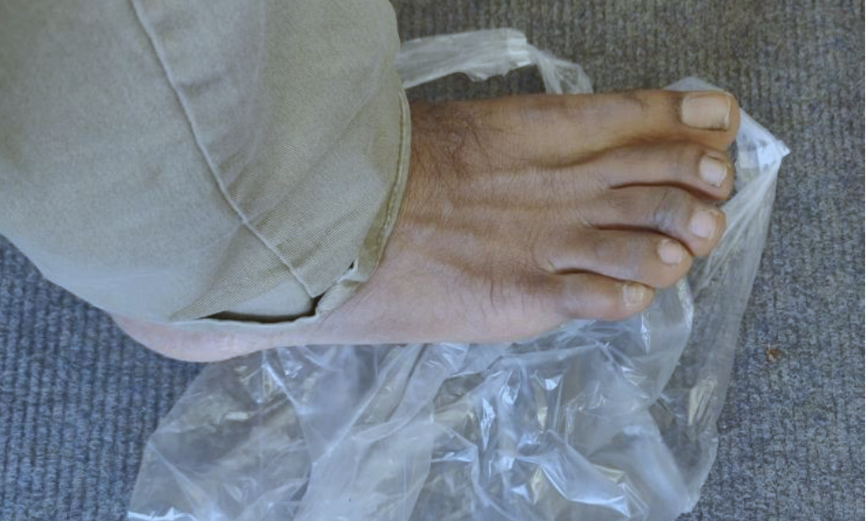
Why?

Slide 5
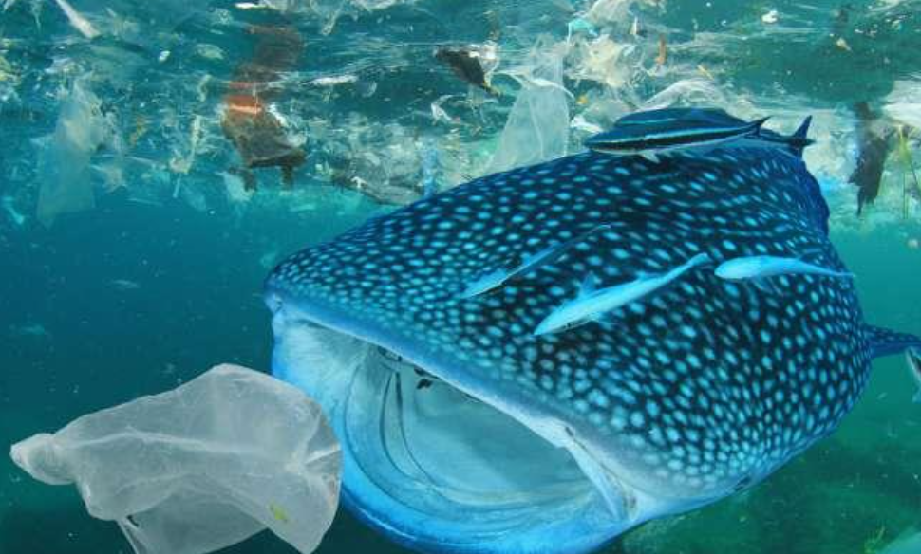
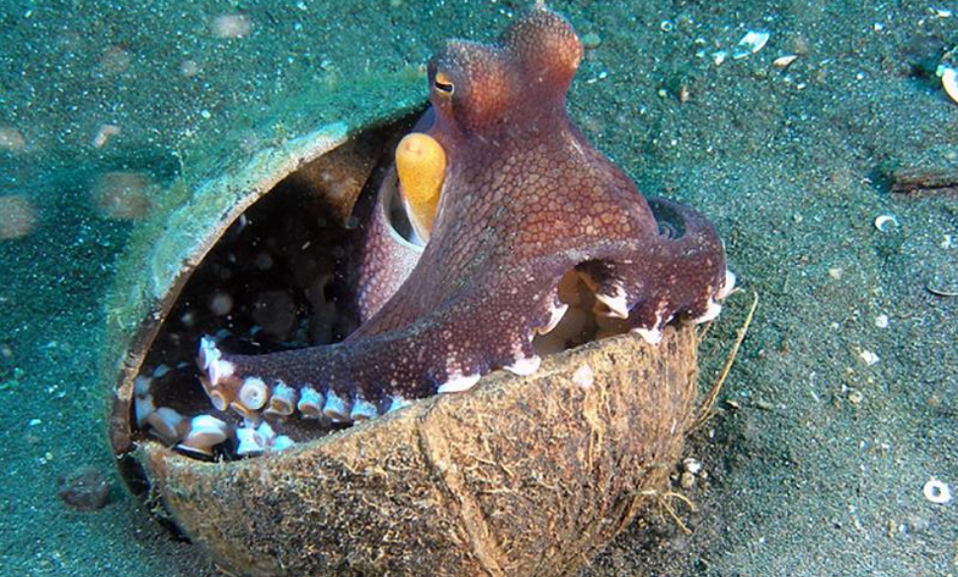
Why?

Slide 6
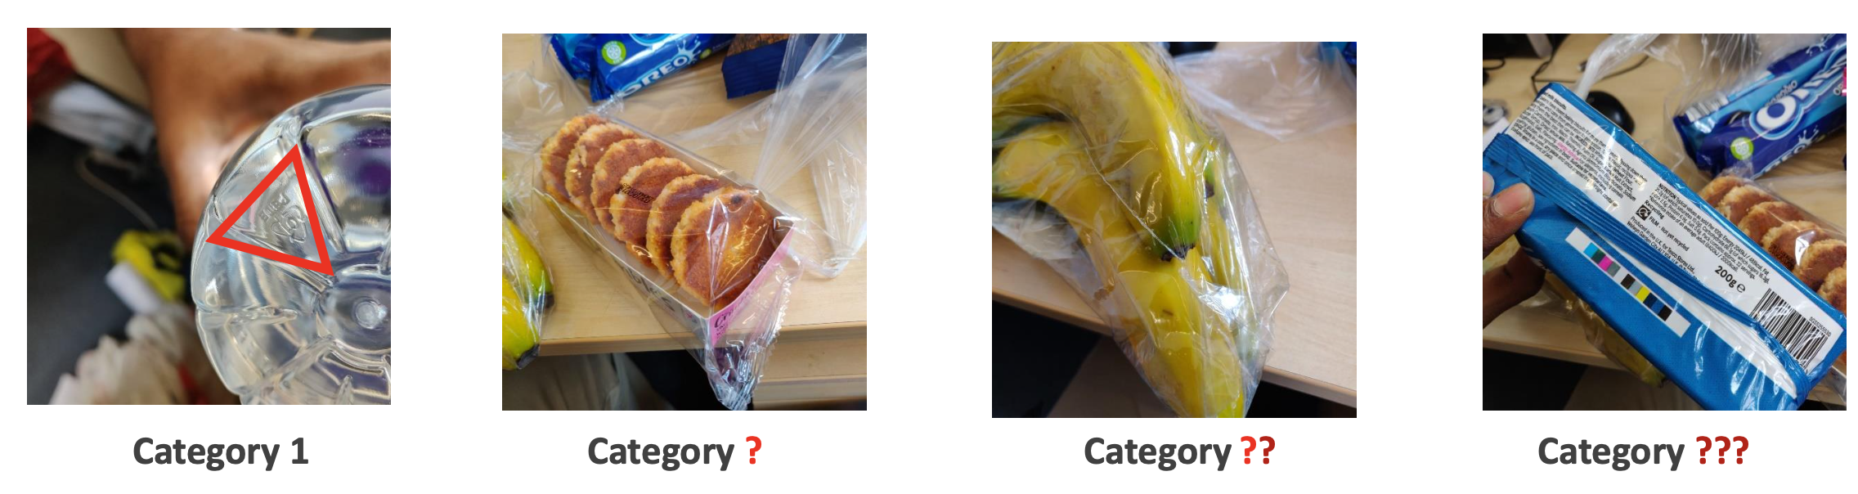
What types of plastic are these products?

Slide 7
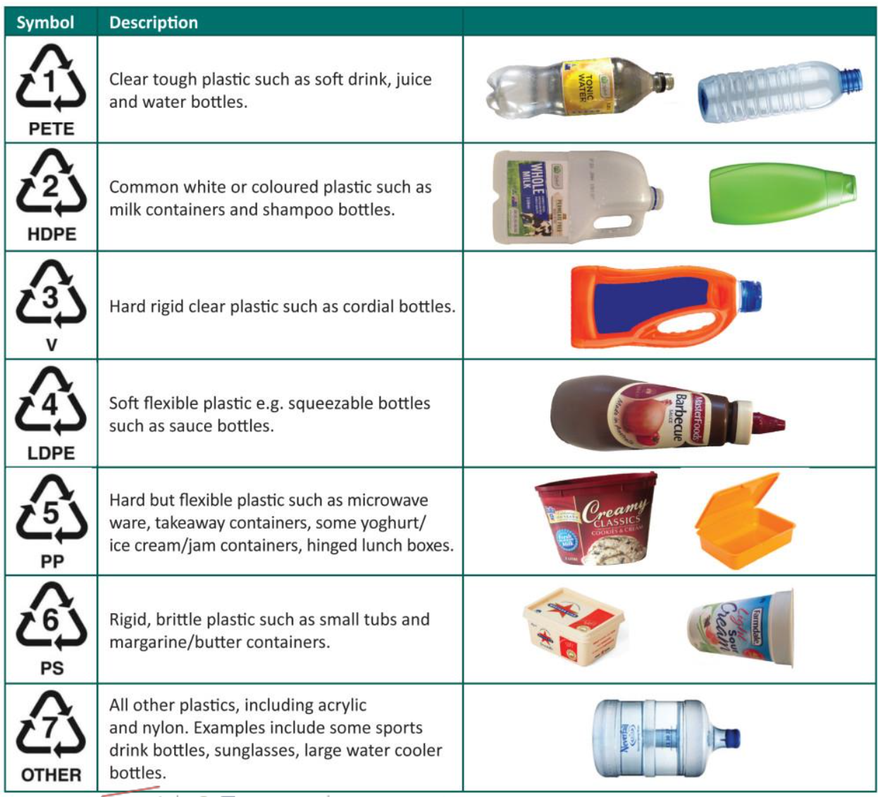
Types of plastic

Slide 8
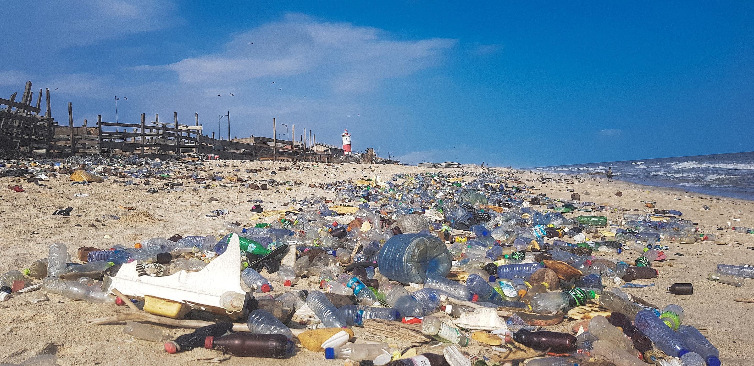
Why?

Slide 9
Demo

Slide 10
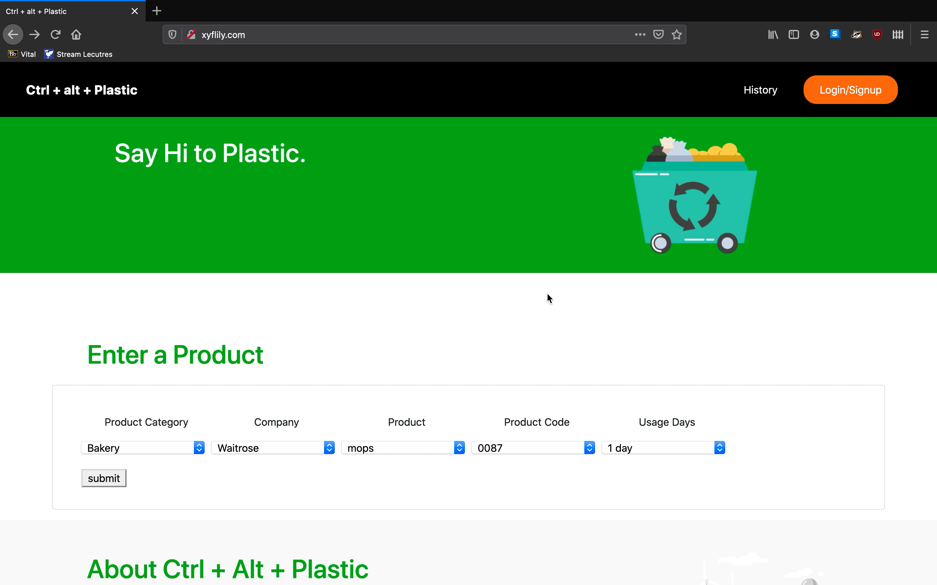

Slide 11
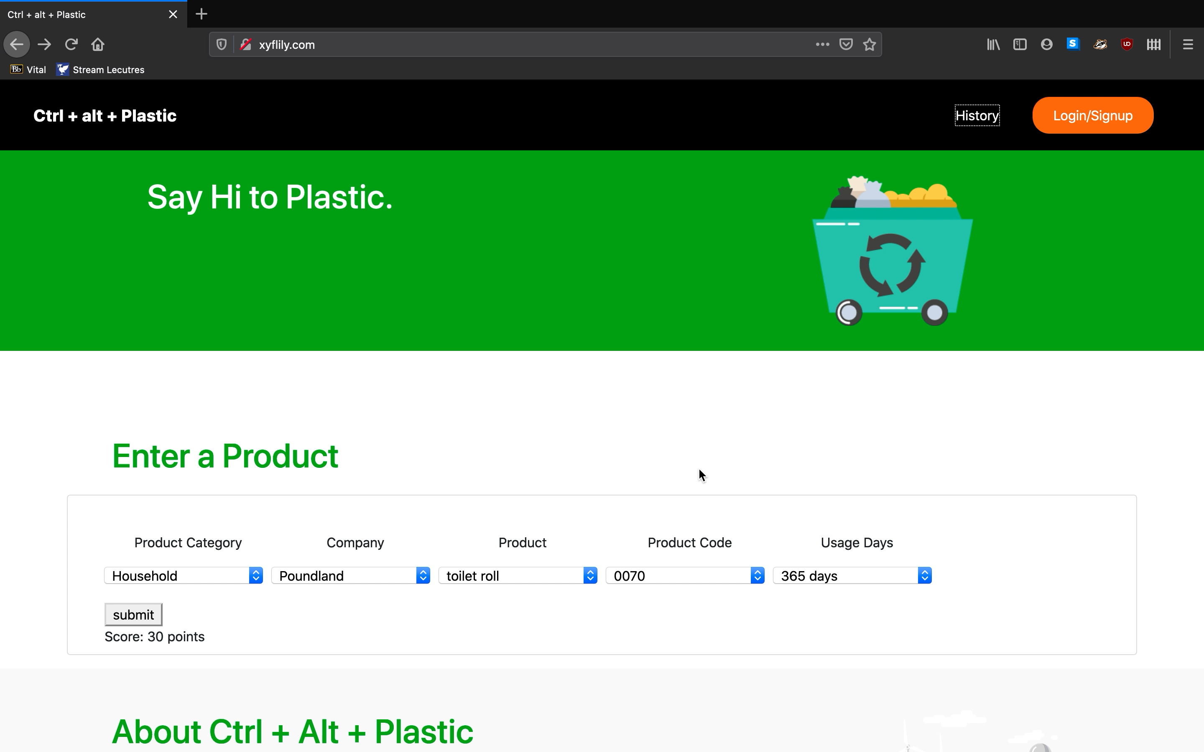

Slide 12
Incentives & Rewards
Plastic Points | Rank | Reward
5,000 | Concerned Citizen | Reusable ASDA Bag
10,000 | Plant Consuming Giraffe | Compost Bin
20,000 | Cola | Metal Water Bottle
50,000 | Panda | Toothpaste Tablets
100,000 | Green Giant | Biodegradable Confetti
1,000,000 | Extinct Rebel | Metal Straw
10,000,000 | Greta Thunberg & Leonardo Dicaprio’s Lovechild | Bamboo Cutlery Set

Slide 13
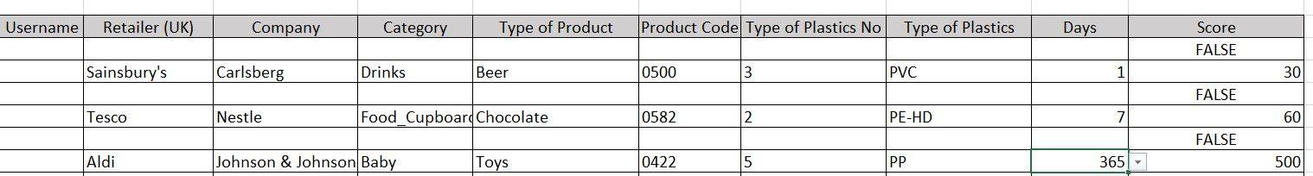
Database

Slide 14
Summary
How will students use this system?
How does this generate value for students?

